Slide 1


BHARATI VIDYAPEETH (DEEMED TO BE UNIVERSITY) COLLEGE OF ENGINEERING, PUNE
DEPARTMENT OF INFORMATION TECHNOLOGY
IT Infrastructure Management PROJECT BASED LEARNING TOPIC – UPI OTP System Using 2 Factor Authentication
PRESENTED BY :-
Roll No. | PRN No. | Name
27 | 2214110260 | R Gokul
11 | 2214110244 | Ekansh Garg
22 | 2214110255 | Kumar Sarthak
59 | 2214110368 | Aditya Tripathi
GUIDED BY :-
Prof. T. B. Patil
B.Tech. (IT) Semester - IV

Slide 2
BHARATI VIDYAPEETH (DEEMED TO BE UNIVERSITY) COLLEGE OF ENGINEERING, PUNE
DEPARTMENT OF INFORMATION TECHNOLOGY
INDEX
Sr.no. | Topic | Pg.No.
1 | Objectives | 3
2 | Overview of UPI | 4
3 | Program & Output | 5

Slide 3
BHARATI VIDYAPEETH (DEEMED TO BE UNIVERSITY) COLLEGE OF ENGINEERING, PUNE
DEPARTMENT OF INFORMATION TECHNOLOGY
Objectives
To create a 2-factor authentication for UPI.
To store contact number of the UPI user with pin.
To store Account balance of the UPI user.

Slide 4
BHARATI VIDYAPEETH (DEEMED TO BE UNIVERSITY) COLLEGE OF ENGINEERING, PUNE
DEPARTMENT OF INFORMATION TECHNOLOGY
The Original Code
In the original code, we had made a code for UPI OTP system using 2 factor authentication in which the OTP was generated on the same output screen as of the screen where the pin was entered and the OTP was not encrypted and it was easily visible to the third user as well.

Slide 5
BHARATI VIDYAPEETH (DEEMED TO BE UNIVERSITY) COLLEGE OF ENGINEERING, PUNE
DEPARTMENT OF INFORMATION TECHNOLOGY
Changes Proposed by Prof. TB Patil Sir
Changes proposed by Patil Sir were:
To create a new login page for the user to enter the OTP.
To encrypt the OTP on the login page and decrypt it at the time of entering the OTP on the new login page.

Slide 6


BHARATI VIDYAPEETH (DEEMED TO BE UNIVERSITY) COLLEGE OF ENGINEERING, PUNE
DEPARTMENT OF INFORMATION TECHNOLOGY
Overview Of UPI
Unified Payments Interface (UPI) is a real-time payment system in India that enables seamless money transfers from one bank account to another instantly and free of charge through a mobile device.
UPI is a fast, real-time system that is available 24*7, 365 days of the year, enabling money transfer and payments within seconds.

Slide 7
BHARATI VIDYAPEETH (DEEMED TO BE UNIVERSITY) COLLEGE OF ENGINEERING, PUNE
DEPARTMENT OF INFORMATION TECHNOLOGY
ITM Topics Used
Database Management System (DBMS):
The code interacts with a MySQL database using the mysql.connector module.
It performs operations like INSERT, SELECT, and UPDATE on the users table.
This demonstrates the use of a DBMS to store user information securely.
User Authentication:
During the "Login" process, the script checks if the provided mobile number and PIN match the stored values in the database.
This is a fundamental aspect of ITM as it ensures secure access to the system.

Slide 8
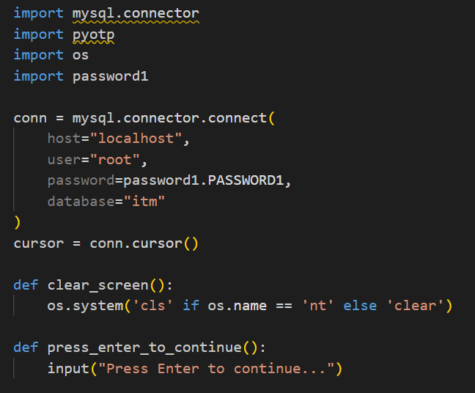
BHARATI VIDYAPEETH (DEEMED TO BE UNIVERSITY) COLLEGE OF ENGINEERING, PUNE
DEPARTMENT OF INFORMATION TECHNOLOGY
Program
We have imported
mysql.connector
Pyotp
os
We have created:
mysql connection
Cursor
We have created a utility function clear screen and a press enter to continue function

Slide 9
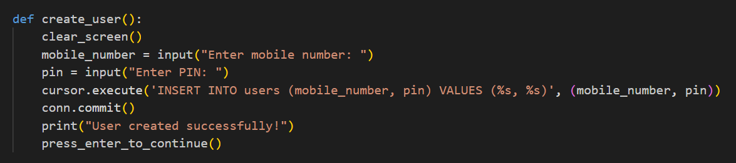
BHARATI VIDYAPEETH (DEEMED TO BE UNIVERSITY) COLLEGE OF ENGINEERING, PUNE
DEPARTMENT OF INFORMATION TECHNOLOGY
Program
We have created a function createuser() where we are taking mobile number and pin from the user, we are then inserting them into the database.
On successful insertion we are a success message.

Slide 10
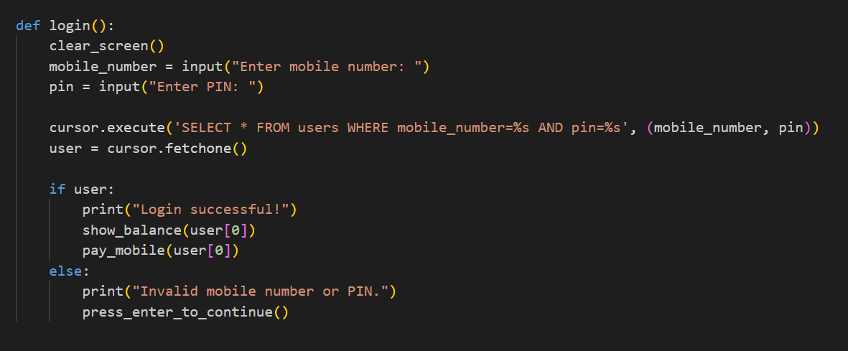
BHARATI VIDYAPEETH (DEEMED TO BE UNIVERSITY) COLLEGE OF ENGINEERING, PUNE
DEPARTMENT OF INFORMATION TECHNOLOGY
Program
We have created a login function where we are taking mobile number and pin from the user.
We are then searching the database for these values, then we are printing a success message or failure message in case any of the values are not found.

Slide 11
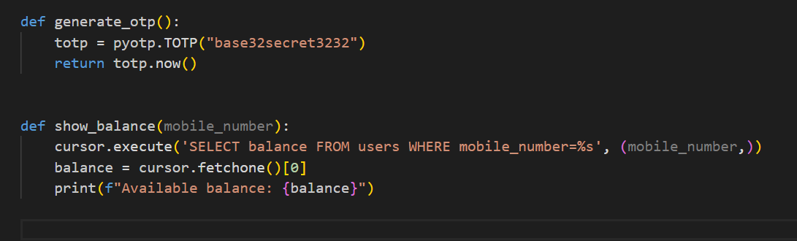
BHARATI VIDYAPEETH (DEEMED TO BE UNIVERSITY) COLLEGE OF ENGINEERING, PUNE
DEPARTMENT OF INFORMATION TECHNOLOGY
Program
We have defined a generate otp function, this generates a time based otp the key for the otp generation is “base32secret3232”.
Now we have defined another function show_balance() with parameter mobile number and then we are searching the database for the mobile number and printing it.

Slide 12
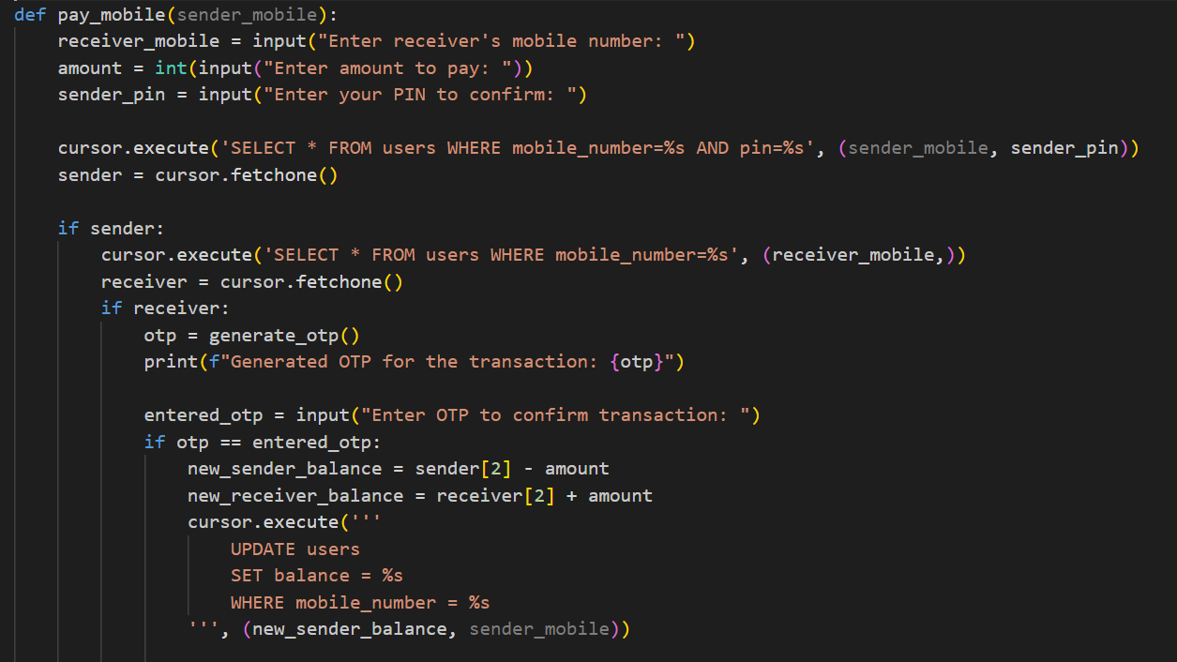
BHARATI VIDYAPEETH (DEEMED TO BE UNIVERSITY) COLLEGE OF ENGINEERING, PUNE
DEPARTMENT OF INFORMATION TECHNOLOGY
Program
We have defined a function pay_mobile with parameter sender mobile, here we are taking receiver mobile number, amount to pay and pin as inputs from the user.
We are then checking if the sender exists in the database, then we are checking if the receiver exists in the database, if both exists we are generating an OTP

Slide 13
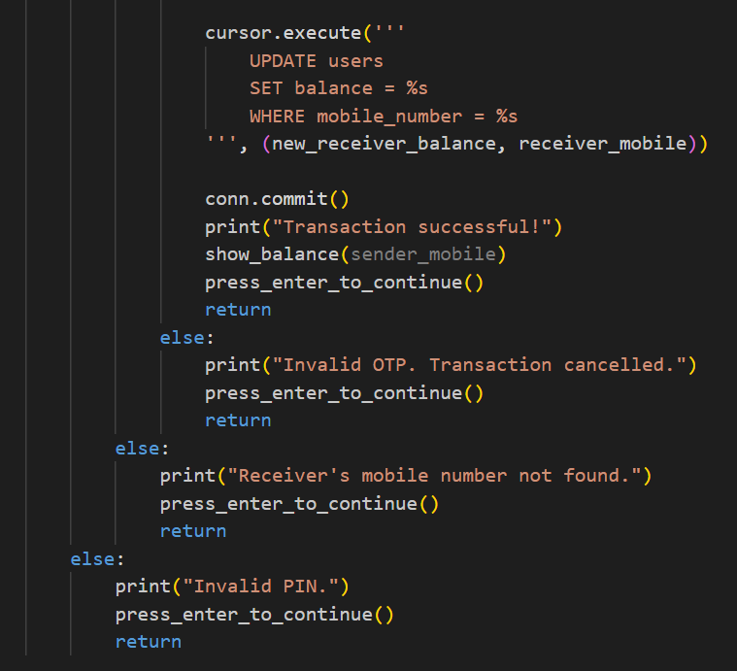
BHARATI VIDYAPEETH (DEEMED TO BE UNIVERSITY) COLLEGE OF ENGINEERING, PUNE
DEPARTMENT OF INFORMATION TECHNOLOGY
Program
If the otp is verified we are updating the balance of the sender and receiver.
If there is any mismatch then we are printing a appropriate error message.

Slide 14
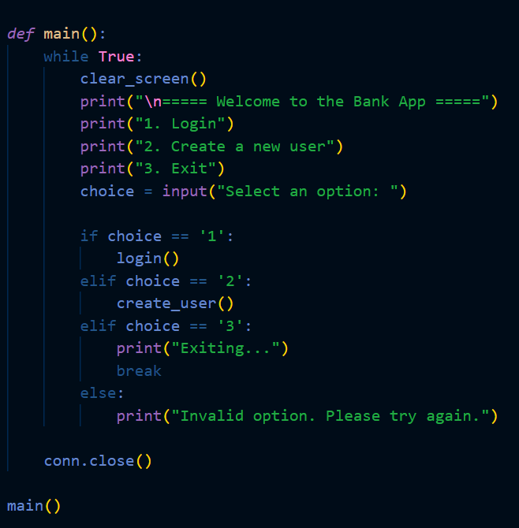
BHARATI VIDYAPEETH (DEEMED TO BE UNIVERSITY) COLLEGE OF ENGINEERING, PUNE
DEPARTMENT OF INFORMATION TECHNOLOGY
Program
Here we have created are main menu and given the user choices on how they want to proceed

Slide 15
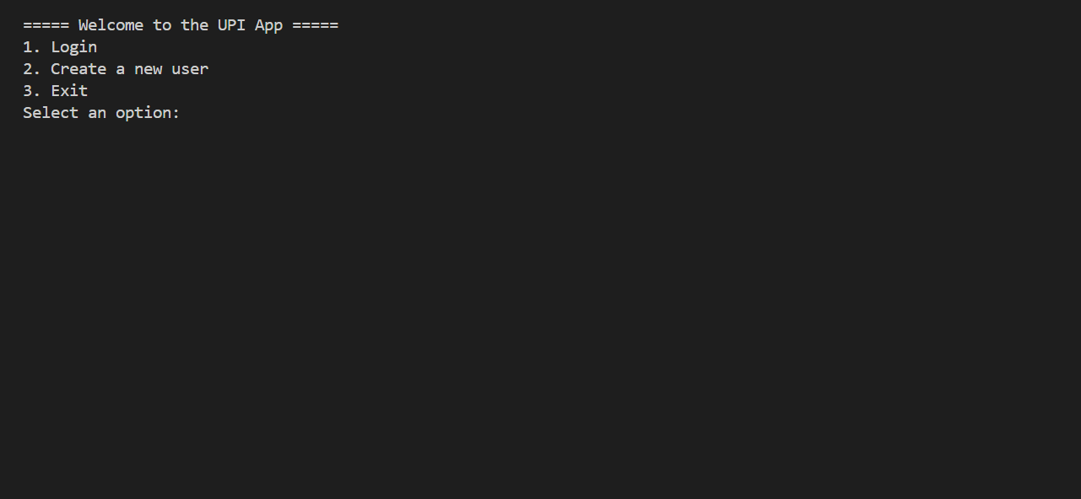
BHARATI VIDYAPEETH (DEEMED TO BE UNIVERSITY) COLLEGE OF ENGINEERING, PUNE
DEPARTMENT OF INFORMATION TECHNOLOGY
OUTPUT SCREENSHOTS

Slide 16
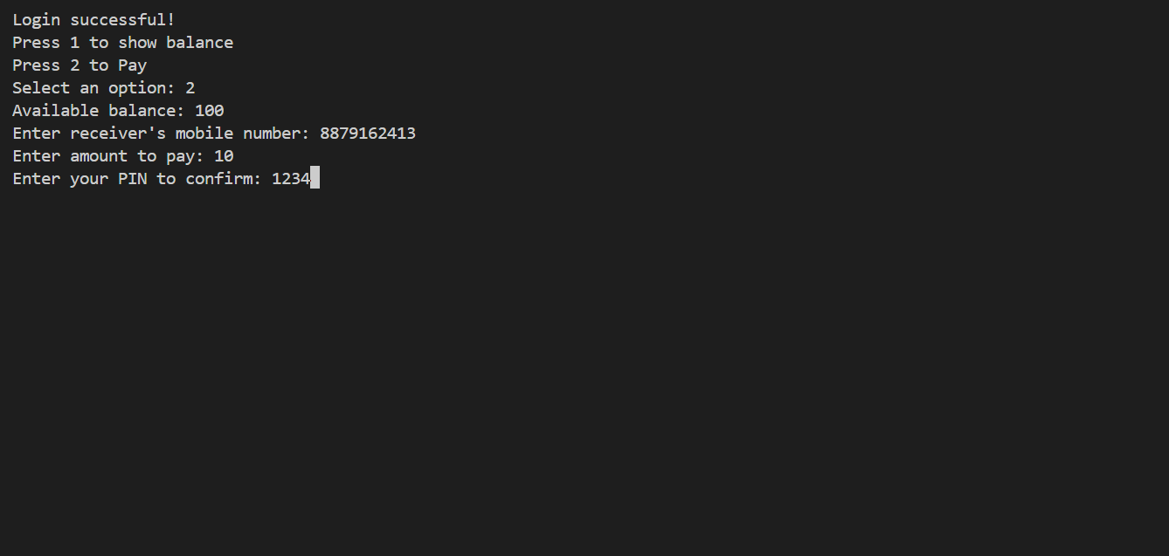
BHARATI VIDYAPEETH (DEEMED TO BE UNIVERSITY) COLLEGE OF ENGINEERING, PUNE
DEPARTMENT OF INFORMATION TECHNOLOGY
OUTPUT SCREENSHOTS

Slide 17
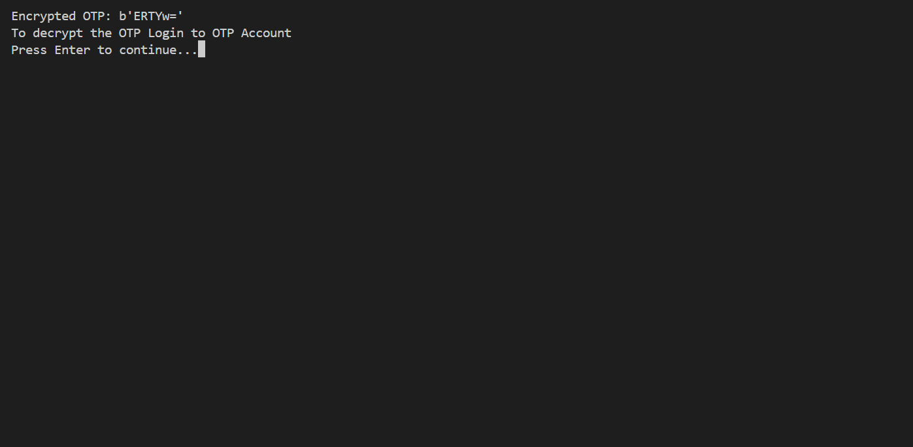
BHARATI VIDYAPEETH (DEEMED TO BE UNIVERSITY) COLLEGE OF ENGINEERING, PUNE
DEPARTMENT OF INFORMATION TECHNOLOGY
OUTPUT SCREENSHOTS

Slide 18
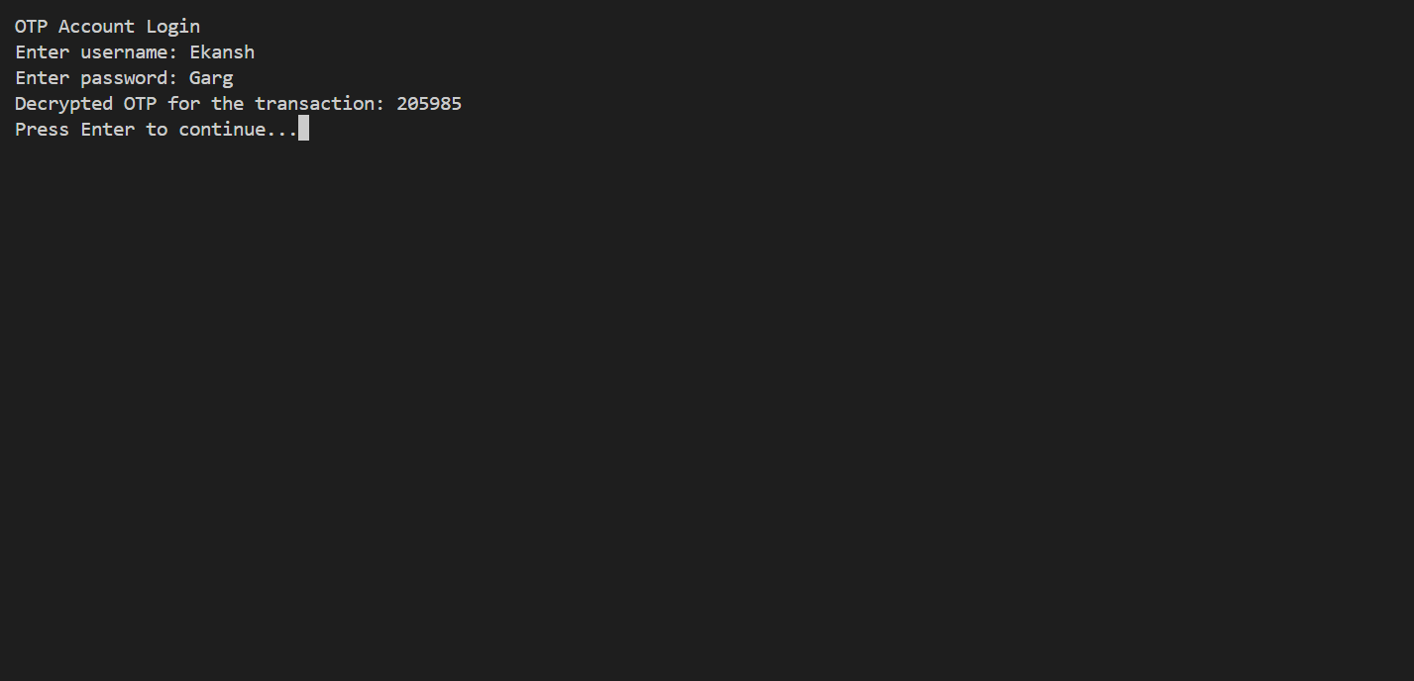
BHARATI VIDYAPEETH (DEEMED TO BE UNIVERSITY) COLLEGE OF ENGINEERING, PUNE
DEPARTMENT OF INFORMATION TECHNOLOGY
OUTPUT SCREENSHOTS

Slide 19
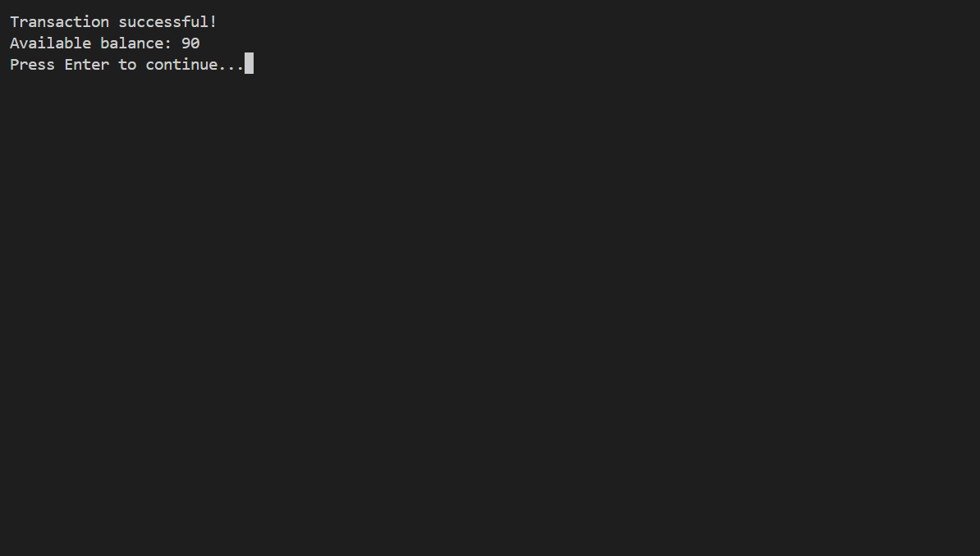
BHARATI VIDYAPEETH (DEEMED TO BE UNIVERSITY) COLLEGE OF ENGINEERING, PUNE
DEPARTMENT OF INFORMATION TECHNOLOGY
OUTPUT SCREENSHOTS

Slide 20
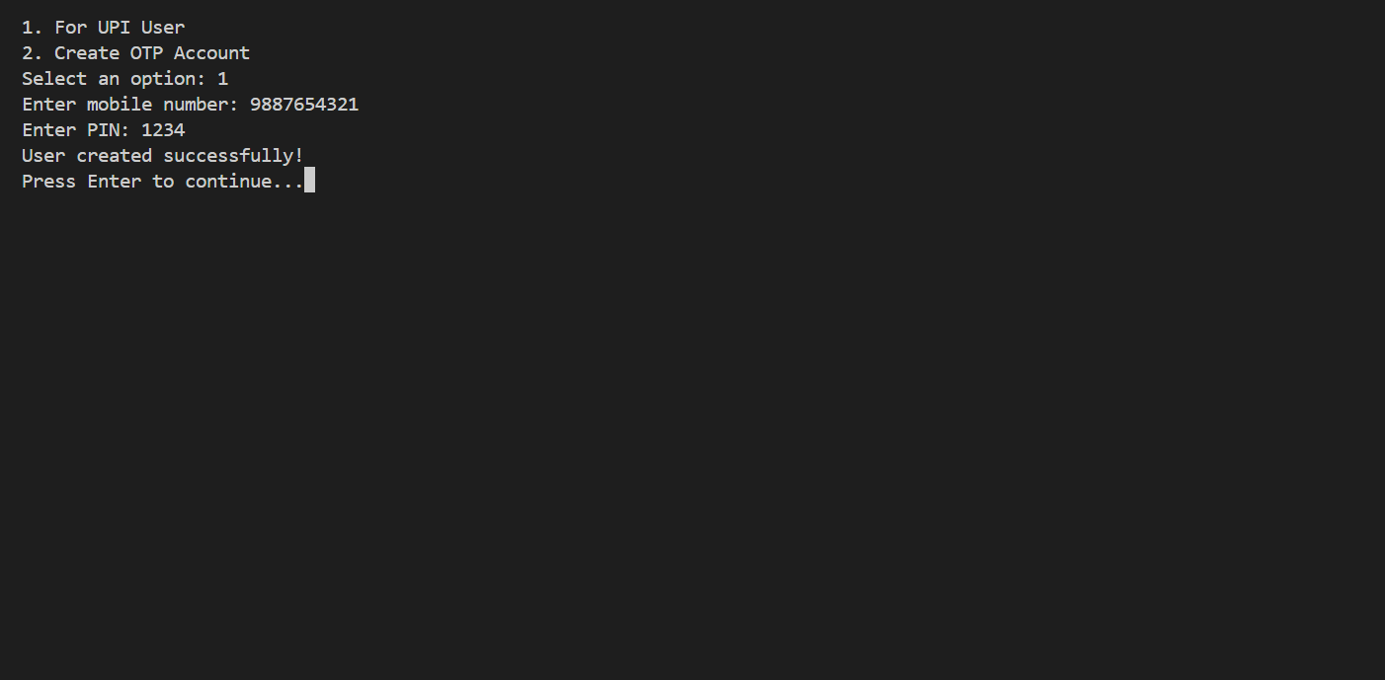
BHARATI VIDYAPEETH (DEEMED TO BE UNIVERSITY) COLLEGE OF ENGINEERING, PUNE
DEPARTMENT OF INFORMATION TECHNOLOGY
OUTPUT SCREENSHOTS

Slide 21
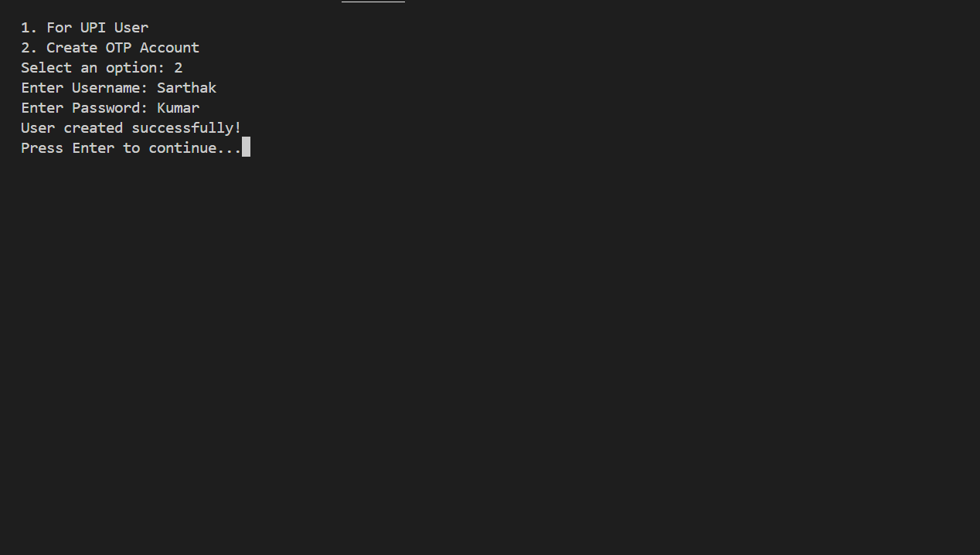
BHARATI VIDYAPEETH (DEEMED TO BE UNIVERSITY) COLLEGE OF ENGINEERING, PUNE
DEPARTMENT OF INFORMATION TECHNOLOGY
OUTPUT SCREENSHOTS

Slide 22
BHARATI VIDYAPEETH (DEEMED TO BE UNIVERSITY) COLLEGE OF ENGINEERING, PUNE
DEPARTMENT OF INFORMATION TECHNOLOGY
REFERENCES
Here are some references we used for the 2 Factor Authentication of UPI OTP program in Python:
https://www.geeksforgeeks.org/c-programming-language/
https://www.w3schools.com/c/c_structs.php
https://www.businessnewsdaily.com/16186-what-is-contactmanagement.htm
https://www.javatpoint.com/c-array
https://www.tutorialspoint.com/cprogramming/c_functions.htm
IDE used Visual Studio Code by Microsoft

Slide 23
BHARATI VIDYAPEETH (DEEMED TO BE UNIVERSITY) COLLEGE OF ENGINEERING, PUNE
DEPARTMENT OF INFORMATION TECHNOLOGY
THANK YOU

